Slide 1
How to Spot Fake News:
Tips on critically evaluating information & News sources
BY
Peter.Reilly@ul.ie

Slide 2
Fake News
What is it?
How to identify
Why it’s dangerous
Impact of Artificial Intelligence
Importance of
Fact Checking
Critically Evaluating
Sources

Slide 3
Learning Outcomes
Identify its various forms
Recognize potential danger to Democracy
Aware of AI’s role in producing Deep Fake Videos
Advocate Fact Checking as effective remedy
Critically Evaluate
Information

Slide 4
Various forms of Fake News
Propaganda
Counter Facts
Satire
Lies
Click Bait

Slide 5
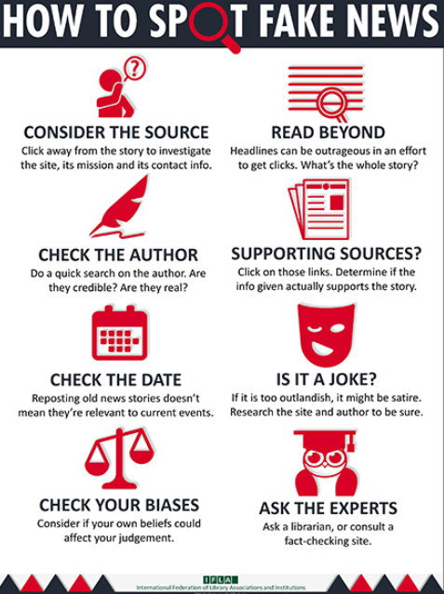
https://repository.ifla.org/bitstream/123456789/167/2/how_to_spot_fake_news.pdf

Slide 6
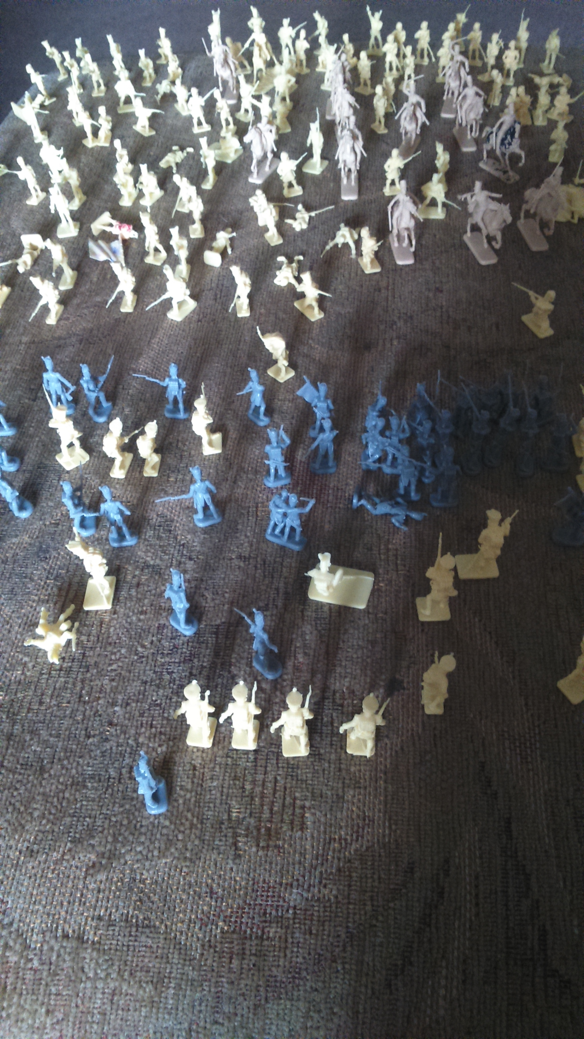
In the Info War Against
Fake News !
“Fact Checking”
Is the best
Way To
Defeat it
Fake News
Fact Checking

Slide 7
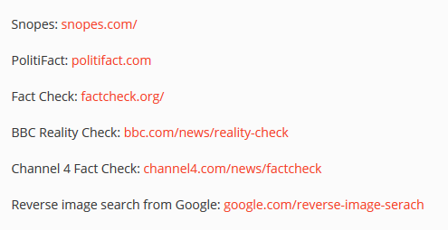
Useful Fact Checking Websites
Sourced from https://www.webwise.ie/teachers/what-is-fake-news/

Slide 8
Fake News is Dangerous to Democracy
Trump Supporters Attack US Congress 6th January 2021
https://www.reuters.com/news/picture/swarms-of-trump-supporters-storm-us-capi-idUSRTX8KJS9
Falsely Believed – US Presidential Election was Stolen

Slide 9
TED Talk – Deep Fake Videos of Real People
How to Create Them

Slide 10
Use S.M.E.L.L to Detect Fake News
SMELL
Source
Motivation
Evidence
Logic
Left Out

Slide 11
Strategies for Critically Evaluating Information
CRAAP
Test
SMELL

Slide 12
Apply CRAAP Test
CRAAP TEST
Currency
Relevance
Authority
Accuracy
Purpose
https://library.csuchico.edu/sites/default/files/craap-test.pdf

Slide 13
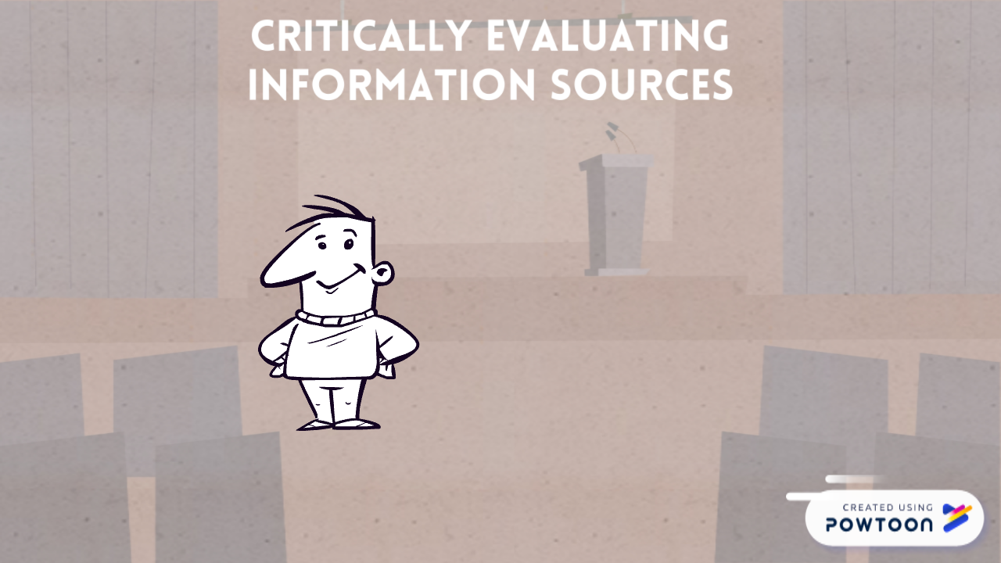

Slide 15
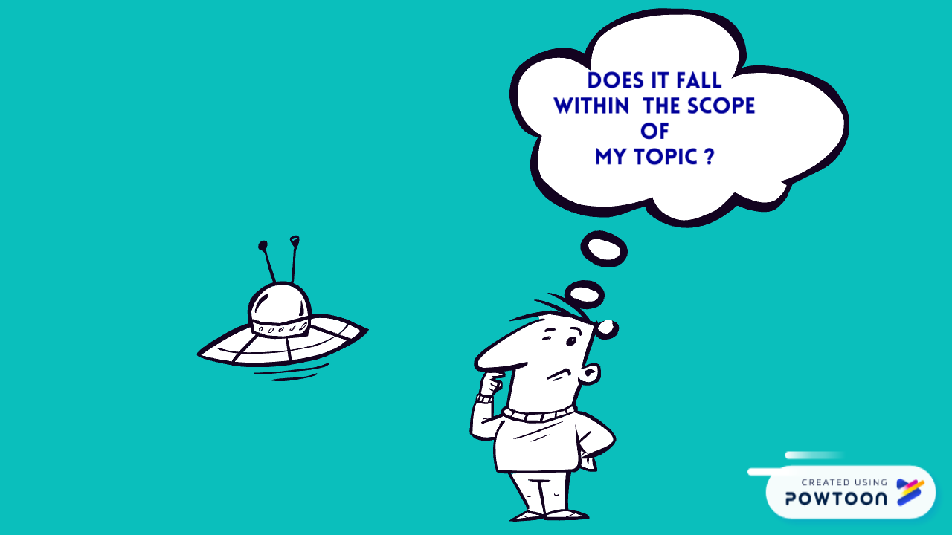
CONSIDER

Slide 16
Author/s

Slide 17
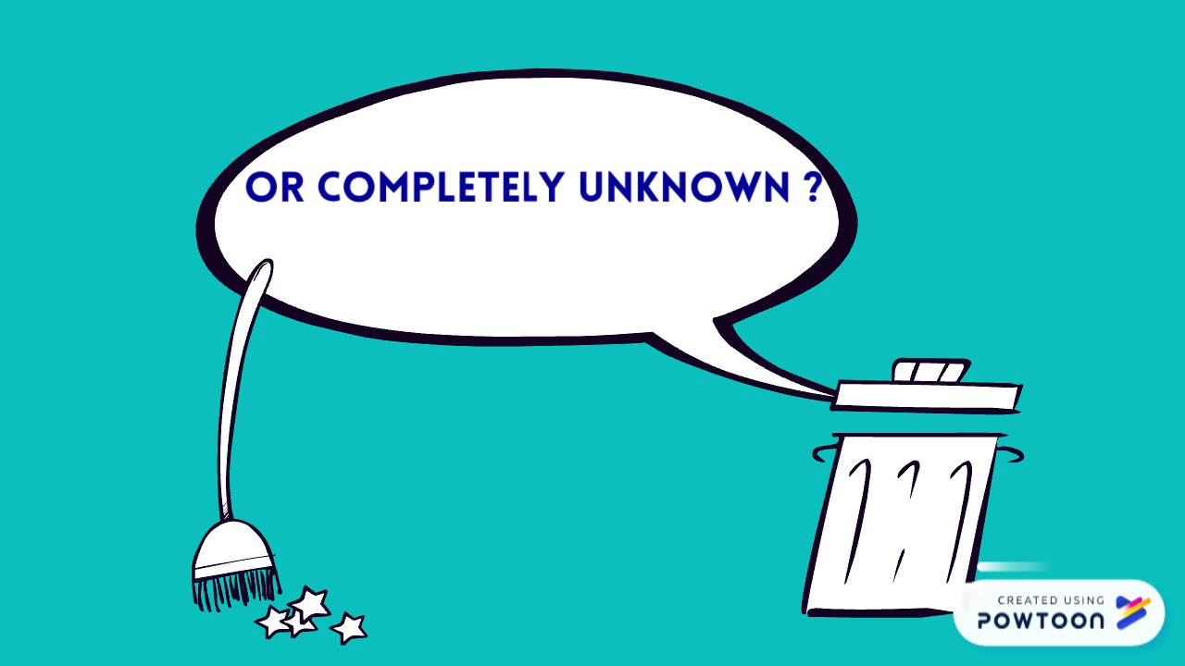

Slide 18
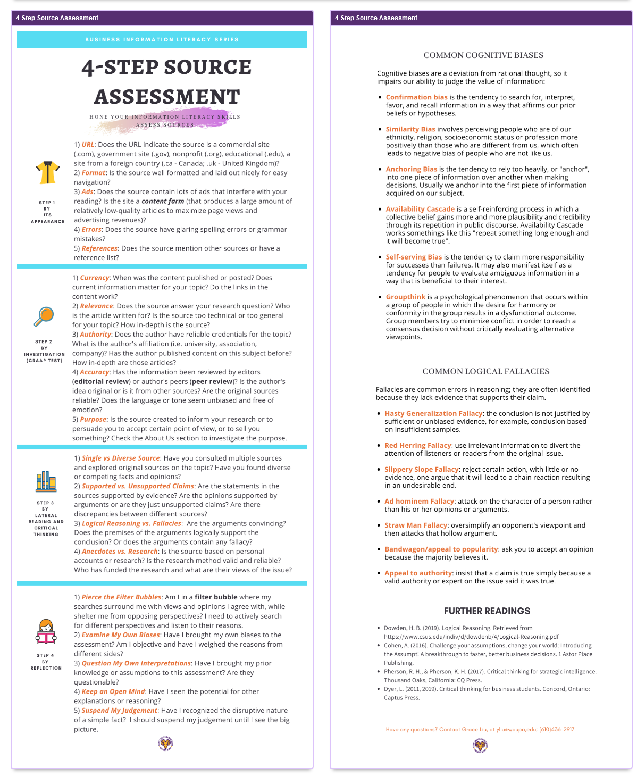
Infographic
On Assessing
Sources
https://library.wcupa.edu/c.php?g=1083914&p=7901322

Slide 19
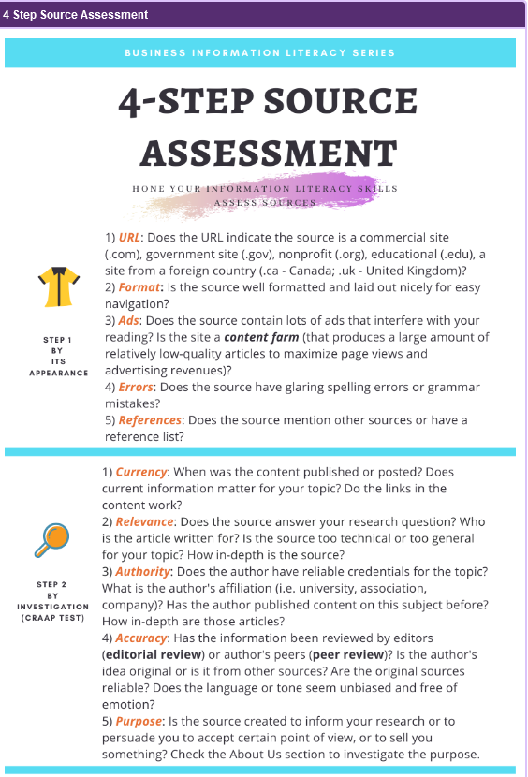
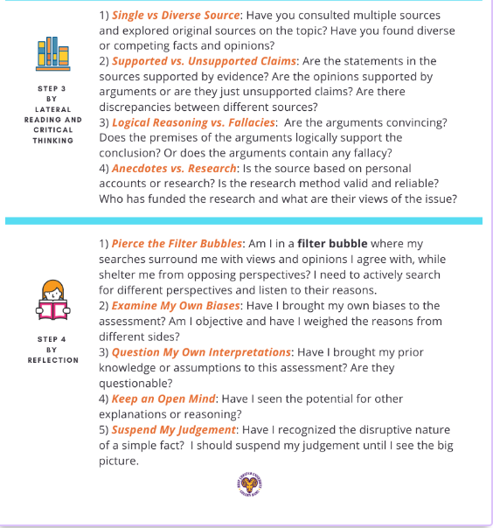

Slide 20
A Quick Recap of Session
Fake News
What is it?
How to identify
Why it’s dangerous
Impact of Artificial Intelligence
Importance of
Fact Checking
Critically Evaluating
Sources

Slide 21
Thank you
ul.ie

